Slide 1
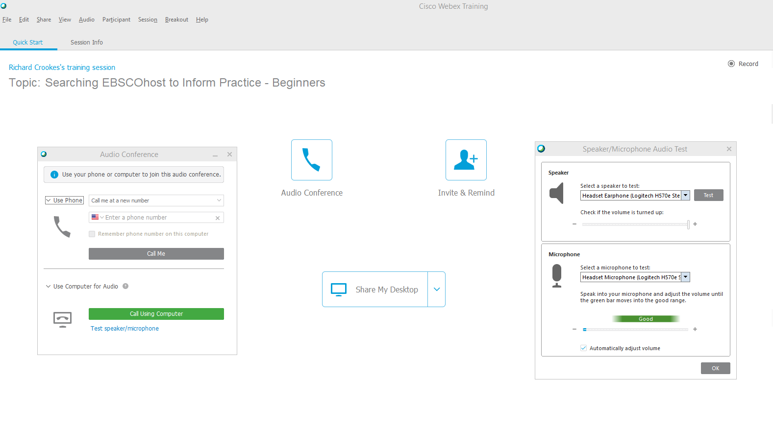
2) “Audio conference” option on Audio tab on the left side of the toolbar
3 options for audio connection
“Audio conference” when you first join.
3) “Audio conference” button in the centre.
Choose Phone or Computer for Audio
Check your Speaker / Microphone via the “Audio” tab on the left side of the toolbar.

Slide 2

Searching EBSCO Databases to Inform Practice - Intermediate
TUSLA – Child & Family Agency, 20th May 2020

Slide 3


Richard Crookes, MA, MCLIP Senior Customer Engagement Manager
EBSCO’s mission is to provide evidence-based resources that inform the global healthcare community.

Slide 4
Objectives
By the end of this session you will be able to:
Understand the use of Boolean search operators
Use the available Subject Indexes
Combine free-text & Subject terms to find articles of interest
Save searches & create search alerts
Find additional information on EBSCO databases

Slide 5
Key Features
Boolean searching
Subject Indexes
Hands-on exercises
Q&A
EBSCO support

Slide 6
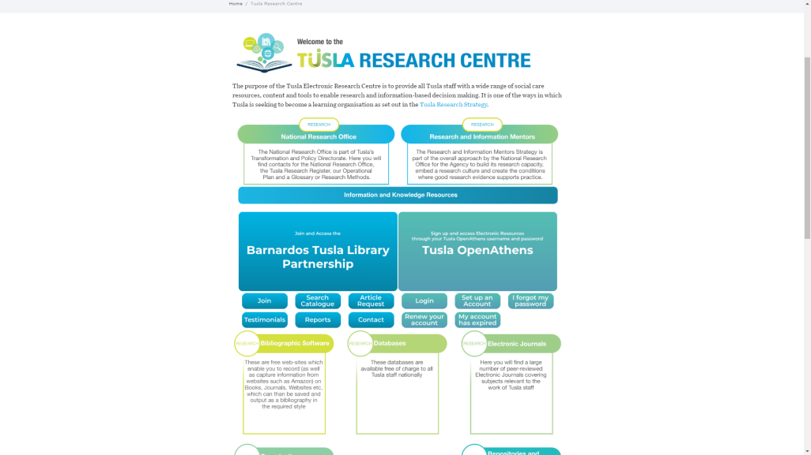
https://www.tusla.ie/research/
Go to databases

Slide 7
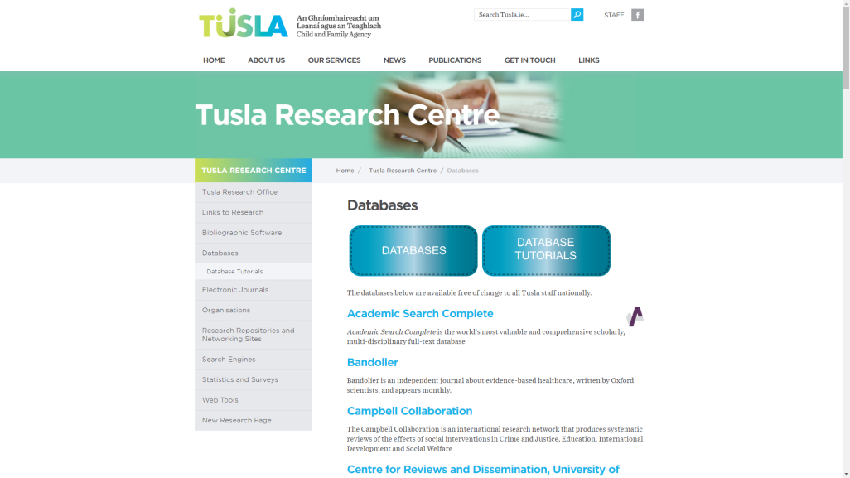
Select available databases from the A-Z list, e.g. Academic Search Complete

Slide 8
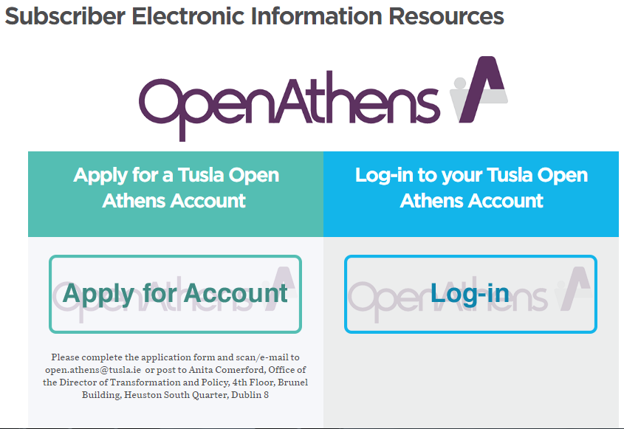
Select Log-in to access databases using your OpenAthens username and password *
No OpenAthens login? Click Apply for Account

Slide 9
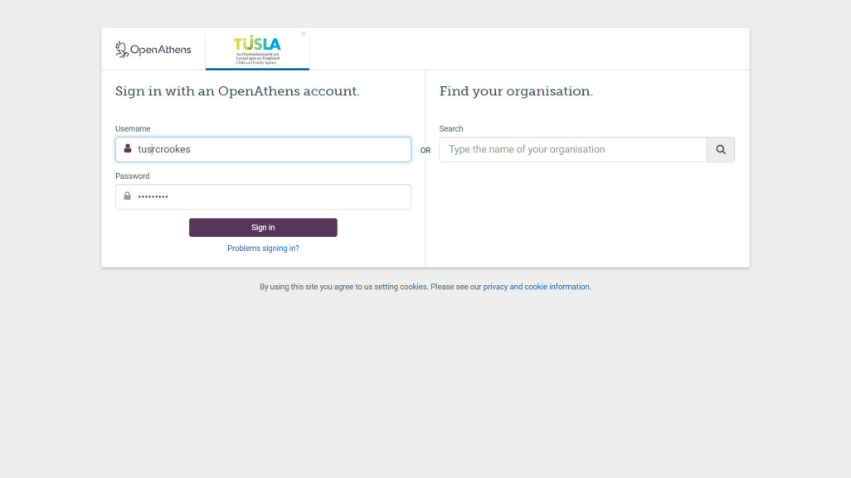

Slide 10
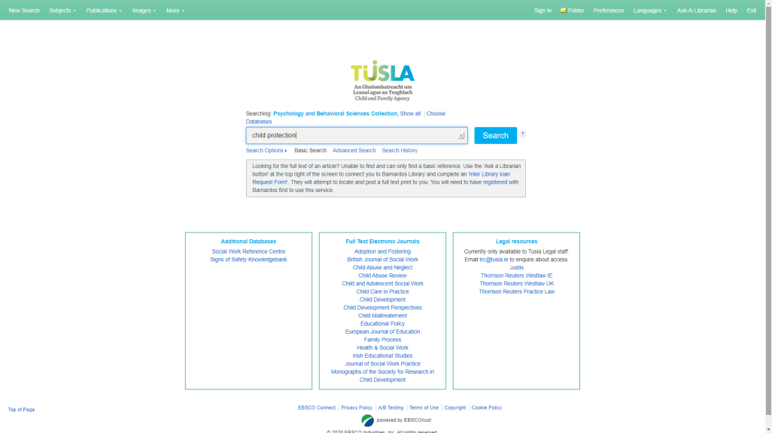
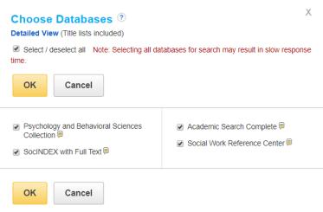
Search across all EBSCOhost Databases all de-select from the list and focus on one.

Slide 11
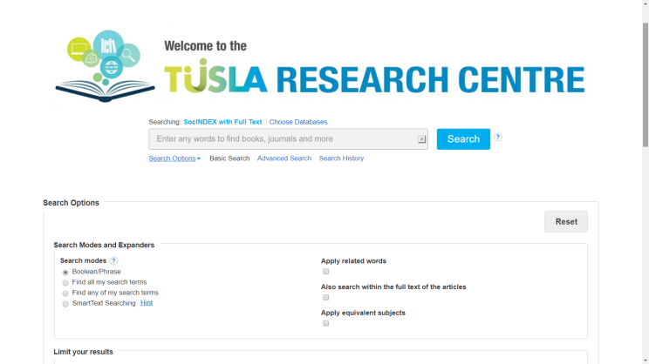
Planning your search (2): Using Search Options

Slide 12
Using Boolean (operators) Searches
Three Basic Combinations
AND, OR, NOT
See also Searching with Boolean Operators

Slide 13
Boolean Searching: Using the AND operator (2)
AND is usually used to narrow results – and tell the database that ALL search terms must be present in the resulting records e.g. children AND homelessness AND Ireland
Homelessness
Children
AND
Ireland

Slide 14
OR Is usually used to broaden results – and tell the database that ANY search terms may be present in the resulting records – but not in combination e.g. children OR paediatrics OR adolescents.
Boolean Searching: Using the OR operator (3)
Children
paediatrics
adolescents

Slide 15
NOT Use NOT in a search to: Exclude words from your search and narrow your search, telling the database to ignore concepts that may be implied by your search terms e.g.: Ireland, NOT Northern Ireland OR United Kingdom
Boolean Searching: Using the NOT operator (4)
Children
Ireland
NOT
Homelessness
Northern Ireland
United Kingdom

Slide 16
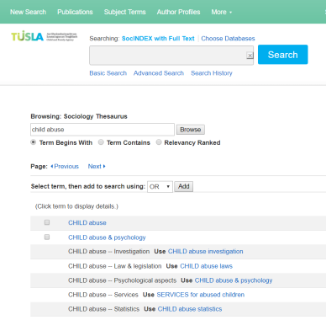
Using Subject Indexes
Subject Headings are terms assigned to articles to describe the content found within the article.
In some databases, Subject Headings may also be referred to as Subject Terms or Controlled Vocabularies
Subject Indexes include: Library of Congress (LC), MeSH (Medical Subject Headings) and APA (American Psychological Association).

Slide 17
Free-text vs subject searching
Free-text or keyword searching allows you to find an exact match of the word(s) you enter e.g. childhood obesity.
Subject-Searching refers to the use of the available Subject Index / Heading which has been assigned to database records e.g. articles, eBooks, reports etc. to describe the content of the database.
Example: free-text e.g. child abuse legislation; Subject Term CHILD ABUSE: Government Policy*
* Academic Search Complete

Slide 18
Using Personal (MyEBSCOhost) Personal Folders
Without an Account
With a MyEBSCOhost Account
Articles saved for the duration of the session
Save/Print/email from the default folders during the session
Export results
Items saved are lost when closing the session
Articles saved beyond the session
Save searches & alerts
Create custom folders
Share folders
Items stored indefinitely unless there is no activity 18 months since the account was setup

Slide 19
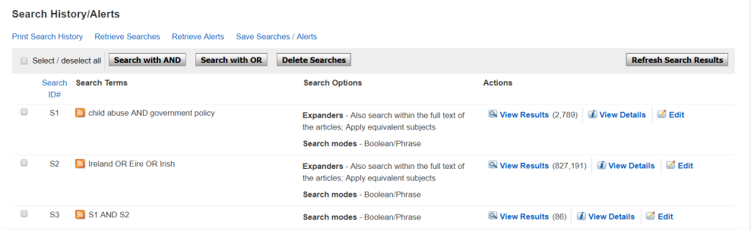
Saving your search I
Go to Search History, Select Search and click Save Searches / Alerts – Sign-in to MyEBSCOhost Folder required to Save Searches

Slide 20
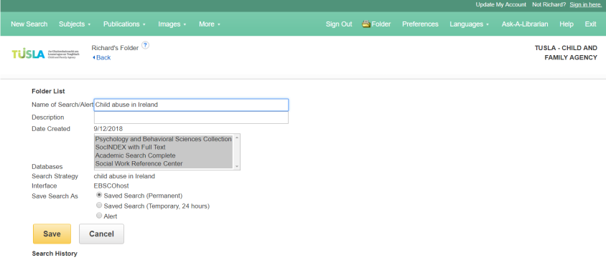
Saving your search II
Add Name, Description (optional) and choose to Save as Permanent or Temporary (24 hours)

Slide 21
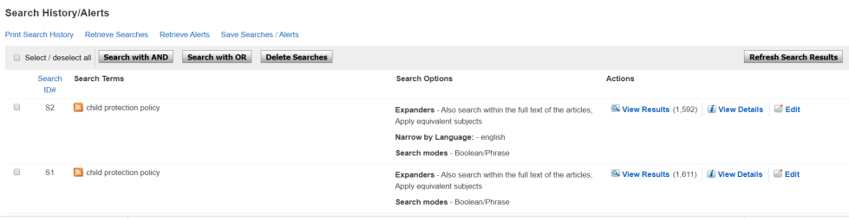
Creating a Search Alert I
Go to Search History, Select Search and click Save Searches / Alerts – Sign-in to MyEBSCOhost Folder required to create a search alert

Slide 22
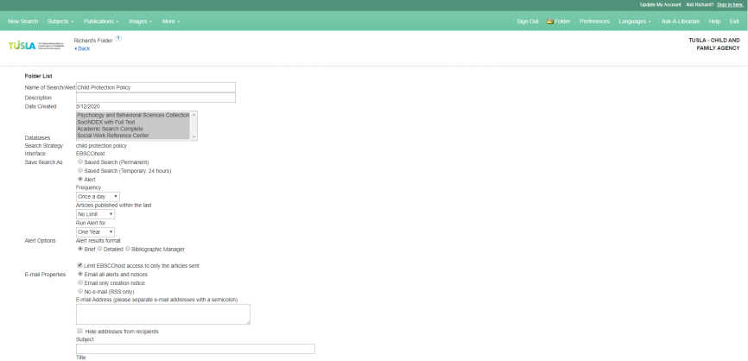
Creating a Search Alert II
Add Name, Description (optional) and choose to Alert and then choose Frequency etc.

Slide 23



Scenarios
Child Protection
Domestic Violence
Prevention, Intervention,
Family support

Slide 24
Hands-On Practice for Intermediate Users
Go to https://www.tusla.ie/research/ to access the EBSCO databases [You will need your OpenAthens login for this].
Choose one of the topics from the previous slide.
Run a keyword (free-text) search.
Browse the Subject index (thesaurus) and run the search.
Combine you keyword (free-text) search with the Subject (thesaurus) Search.
Limit your search and save it to the folder.
Create a search alert [You will need a personal, MyEBSCOhost account for this].

Slide 25

Questions?

Slide 26
EBSCO Support Materials
YouTube tutorials & webinar recordings
Searching with Boolean Operators
Browsing Subject Terms in EBSCOhost Databases - Tutorial
Using the EBSCOhost Search History Tutorial
Saving Your Search History using My EBSCOhost
Creating a Search Alert in EBSCOhost - Tutorial
User guides, helpsheets, FAQs & flyers

Slide 27

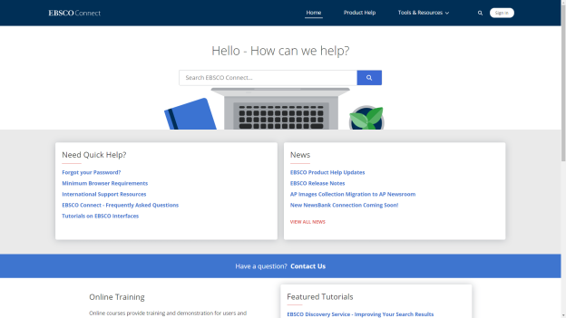
EBSCO Help & Support https://connect.ebsco.com
INSERT SCREENSHOT HERE

Slide 28

Thank you! go raibh maith agat!
Richard Crookes MA, MCLIP | Senior Customer Engagement Manager – UK & Ireland
rcrookes@ebsco.com
+44 (0) 781 218 7726

