Slide 1


Slide 2
What do we know about school absence in Ireland?
Emer Smyth, Anna Moya, Merike Darmody, ESRI.

Slide 3
Outline
01
Patterns of school absence
02
Drivers of absence
03
Consequences of school absence
04
Conclusions and policy implications

Slide 4
Introduction
On-going research programme between TESS and
the ESRI, using evidence to inform policy and practice
Use TESS administrative data to explore patterns
of absence across schools
Draw on Growing Up in Ireland data to look at the
causes and consequences of school absence
Evaluation of the ANSEO programme with schools

Slide 5
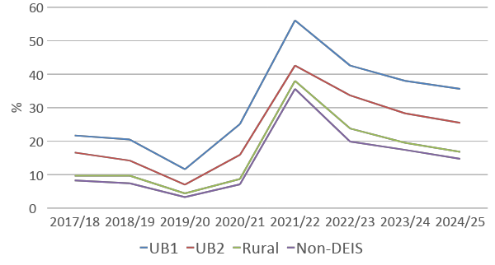
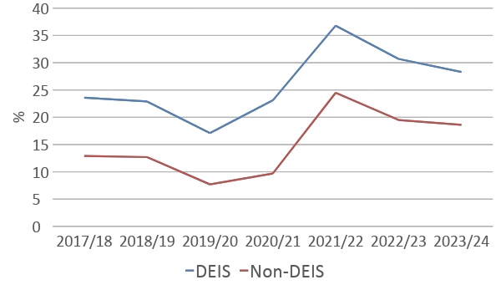
Trends in chronic absence (20+ days) by DEIS
Higher rates of chronic absence in:
Special schools
Schools in disadvantaged areas (over and above their DEIS status)

Slide 6

School absence among 13-year-olds
Risk factors at the individual and family level:
Disability is strongly related to missing school, even taking
account of a range of factors
Strongly socially differentiated: higher rates among unskilled manual and non-employed families, those whose mothers have lower levels of education, families experiencing financial strain and lone-parent households
Migrant-origin young people have better attendance
Family stressors, including maternal depression and adverse life events
Family processes and relations, including mother-child conflict, parenting style and lack of routine

Slide 7


School absence among 13-year-olds
Risk factors at the school level:
DEIS schools (related to the concentration of socio-economic disadvantage)
Having negative interaction with teachers, such as being reprimanded
Absence is lower where students are more involved in decision-making
Having been bullied or picked on at age 9 is related to later absence
Attending a high-absence primary school
Risk factors at the area level:
Rented accommodation and those living in areas with low social capital
(that is, with lower community bonds and poorer facilities for teenagers)

Slide 8
School absence is dynamic
Absence levels tend to increase for young people whose disability emerges or is recognised between ages 9 and 13
Adverse events, such as parental separation, bereavement, poorer health, and addiction, between ages 9 and 13 predict increasing absence
Not liking post-primary school and negative interactions with teachers play an important role in maintaining or prompting poor attendance
Attendance disimproves for those who experienced increased socio-emotional difficulties in the wake of the pandemic

Slide 9

Trends between cohorts
Absence rates are stable at age 9 but increase significantly among 13-year-olds
The impact of two main factors appears to have strengthened over time:
Not liking school
Higher levels of emotional and conduct difficulties at age 9 and higher levels of emotional, conduct, hyperactivity and peer difficulties at age 13

Slide 10
Educational consequences of school absence
Lower Leaving Certificate grades – a gap of 80 CAO points between those missing 20+ days at 13 and those with no absence
Longer absence is linked to poorer perceptions of the benefits of education, including increasing their self-confidence and helping them develop into a well-balanced person
Much less likely to obtain a degree by age 25 – the gap is as large as the difference by parental education

Slide 11
Long-term consequences of school absence
Labour market:
  Lower income for those missing 11+ days at 13
  Less likely to be in a professional/managerial job
Wellbeing:
  Less satisfied with life at age 25
  More depressive symptoms
  Report less trust in other people

Slide 12
Conclusions
School absence is influenced by a range of individual, family, neighbourhood and school factors, suggesting the need for policy responses to be multi-dimensional, integrated and dynamic
It disrupts key aspects of young people’s educational and broader development that help their wellbeing in later life and their integration into employment
It contributes to social inequality in educational and employment outcomes as well as trust in others

